Slide 1
Head Injury -2
Dr. Tanveen Kamal
Assistant Professor
Department of Neurosurgery

Slide 2
Primary survey
● Ensure adequate oxygenation and circulation
● Exclude hypoglycaemia
● Check pupil size and response and GCS score as soon as possible
● Check for focal neurological deficits before intubation if possible

Slide 3
SECONDARY SURVEY
RESUSCITATION USING ATLS PROTOCOL
The history obtained in parallel is key to shaping ongoing management
Neurological Progression
Pupils
GCS
NEUROLOGICAL deficits

Slide 4
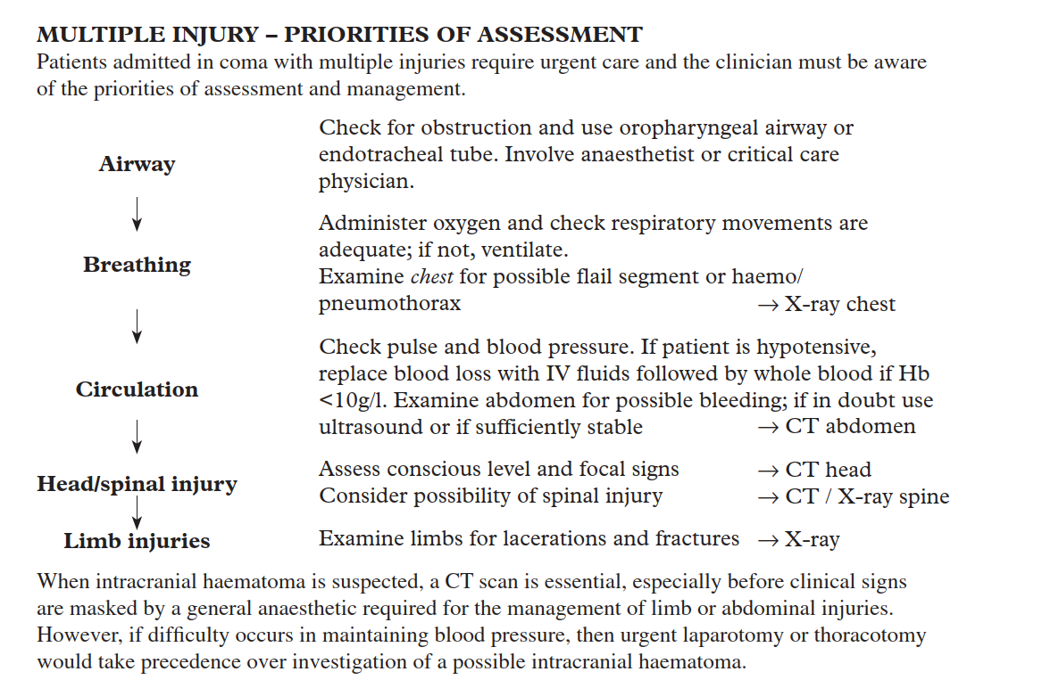

Slide 5
Consciousness is described in terms of
EYE OPENING,
VERBAL RESPONSE AND
MOTOR RESPONSE

Slide 6
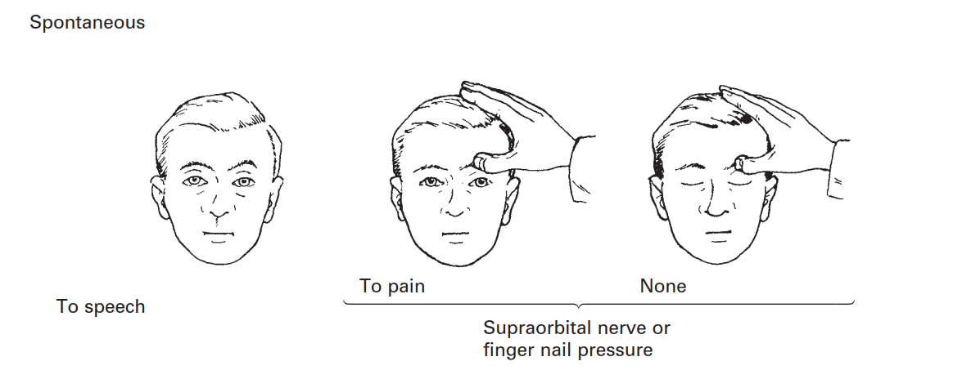




EYE OPENING -4 CATEGORIES
4
2
1
3

Slide 7
EYE OPENING -4 CATEGORIES-DESCRIPTION
Patient’s visual or eye response
Score your patient a 4 if he/she can open their eyes spontaneously
Score your patient a 3 if they open their eyes to verbal speech -“Mr. X”or light touch
Score your patient a 2 if your patient requires painful stimuli to open their eyes
Score your patient a 1 if their eyes do not open. Patient is unresponsive.

Slide 8
VERBAL RESPONSE- 5 categories
Patient’s verbal response (if intubated or tracheotomy score NT=not testable / T=Tube)
Score your patient a 5 if patient is oriented x 3 (He or she knows who they are, where they are, and what the date is)
Score your patient a 4 if you not they are having some confusion or forgetfulness (unable to answer all orientation questions)
Score your patient a 3 if they are not understood and using inappropriate words (i.e. swearing, unrelated words, aggressive)
Score your patient a 2 if they are not able to form words and just can make sounds
Score your patient a 1 if they are unresponsive and make no noise

Slide 9
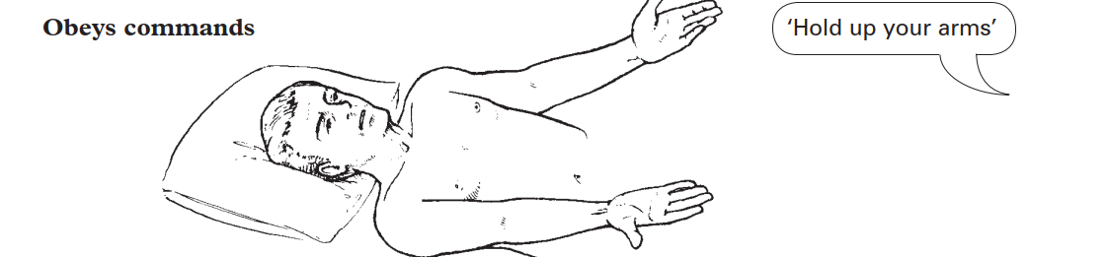
MOTOR RESPONSE
Motor Response -6 Categories
6

Slide 10
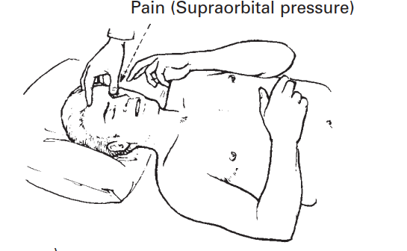
Localizing to pain
Apply a painful stimulus to the supraorbital nerve,
e.g. rub thumb nail in the supraorbital groove, increasing pressure until a response is
obtained
5

Slide 11
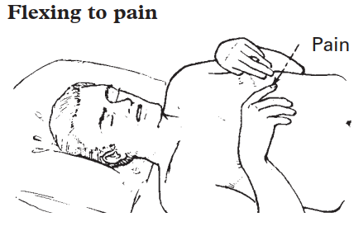
If the patient does not localize to supraorbital pressure, apply pressure with a pen or hard
object to the nail bed. Record elbow flexion as
‘flexing to pain’.
4

Slide 12
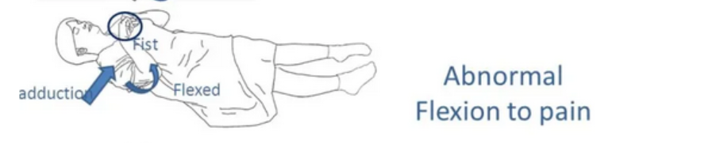
3
Abnormal flexion to a painful stimulus typically involves
Adduction of the arm,
internal rotation of the shoulder,
flexion of the elbow,
pronation of the forearm and wrist flexion (known as decorticate posturing).

Slide 13
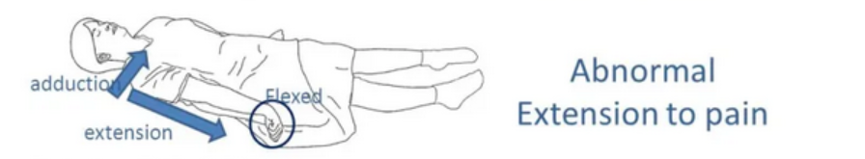
2
Abnormal extension to a painful stimulus is also known as decerebrate posturing.
In decerebrate posturing, the head is extended, with the arms and legs also extended and internally rotated.
The patient appears rigid with their teeth clenched.
The signs can be on just one side of the body or on both sides (the signs may only be present in the upper limbs)

Slide 14
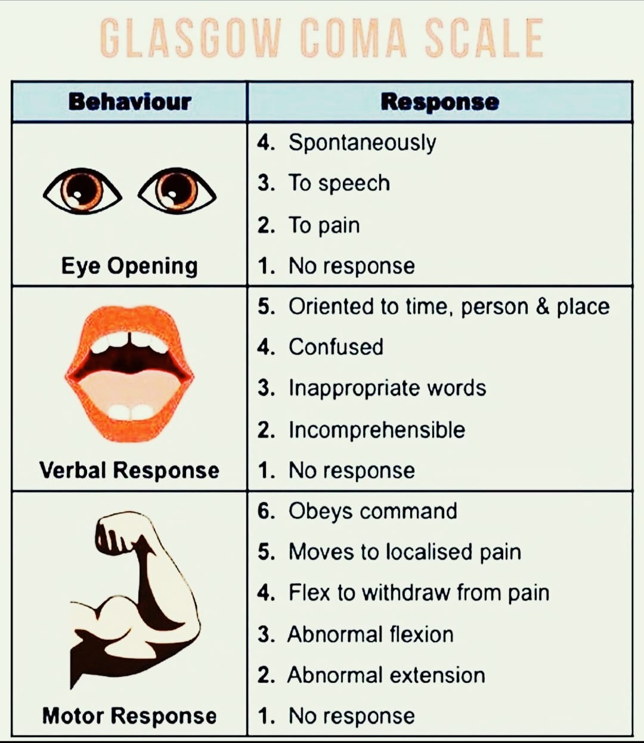
GCS (Glasgow Coma Scale)

Slide 15
Skull X ray
With the development of more advanced imaging techniques, skull X-ray is now less often used, but may still provide useful information
Standard views:
Lateral
Postero-anterior
Towne’s (fronto-occipital)

Slide 16
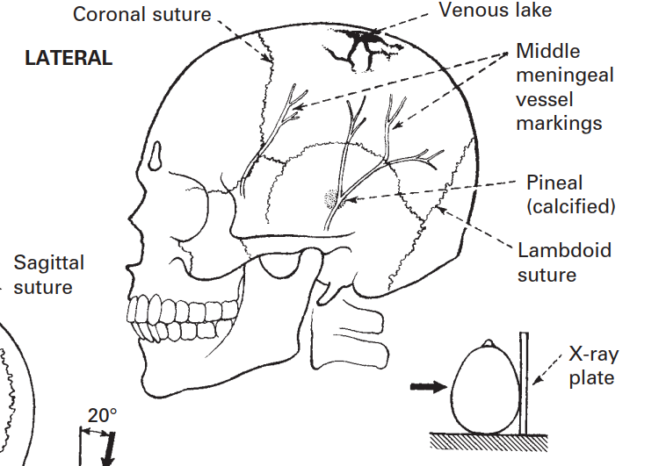












Slide 17
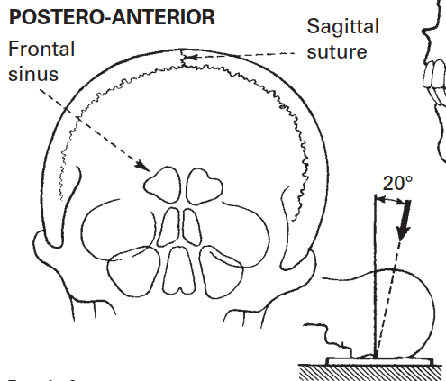




Slide 18
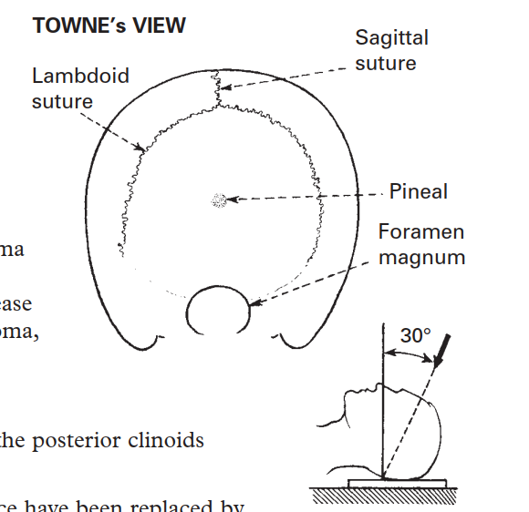






Slide 19
Skull xray –what is it used for?
Fractures
Bone erosion – focal, e.g. pituitary fossa – generalised, e.g. multiple myeloma
Bone hyperostosis – focal, e.g. meningioma– generalised, e.g. Paget’s disease
Abnormal calcification – tumours, e.g. meningioma, craniopharyngioma
Midline shift – if pineal is calcified
Signs of raised intracranial pressure – erosion of the posterior clinoids

Slide 20
Surgical pathology
Fractures
Skull vault Closed linear fractures of the skull vault are managed conservatively
Open or comminuted fractures should be considered for debridement and prophylactic antibiotic therapy

Slide 21
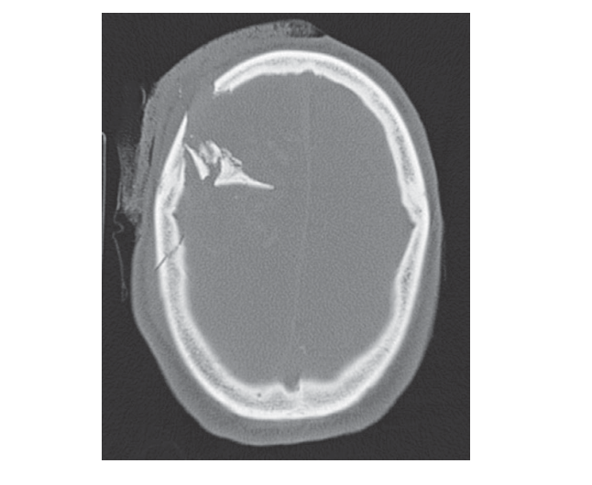
A right frontal comminuted depressed skull fracture, with a linear undisplaced fracture of the right parietal bone visible
posteriorly

Slide 22
Depressed skull fractures involve inward displacement of a bone fragment by at least the thickness of the skull.
. They are usually compound (open) fractures, and are associated with a high incidence of infection, neurological deficit and late-onset epilepsy.
These fractures require exploration and elevation, fractures that involve the air sinuses should generally be managed as open fractures, using broad-spectrum antibiotics with or without exploration

Slide 23
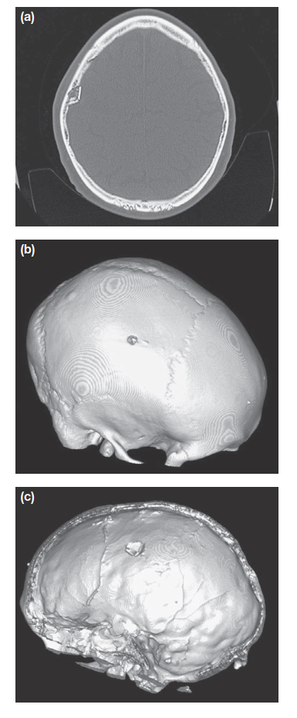
(a–c) A small depressed skull fracture of the parietal bone visible on an axial bone window (a), visualised on bone vault reconstructions
(b) with an underlying breach of the dura (c)

Slide 24
Extradural haematoma
Extradural haematoma is a neurosurgical emergency. It results from
rupture of an artery(Middle Meningeal Artery or vein)-most commonly,
Or injury to venous sinus, in association with a skull fracture
Transient loss of consciousness is typical, and the patient may then present in the subsequent lucid interval with headache but without any neurological defcit.
As the haematoma expands, compensation is exhausted, with rapid deterioration

Slide 25
There is
contralateral hemiparesis,
a reduced conscious level
and ipsilateral pupillary dilatation,
the cardinal signs of brain compression and herniation.
Although this ‘talk and die’ pattern of deterioration occurs in only one-third of cases-ITS EXTREMELY IMPORTANT TO RECOGNISE .

Slide 26
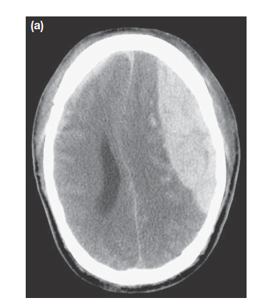
On CT, extradural haematomas appear as a lentiform
(lens-shaped or biconvex) hyperdense lesion between the skull and the brain, constrained by the adherence of the dura to the skull. A mass effect may be evident, with compression of the surrounding brain and midline shift

Slide 27
Extradural haemorrhage
Extradural haemorrhage
● Can follow relatively minor trauma with brief loss of consciousness
● Followed by a lucid interval and then sudden deterioration
● Lentiform lesion on CT
● Require immediate transfer to a neurosurgical unit for decision on evacuation
The prognosis for promptly evacuated extradural haematoma, without associated primary brain injury, is excellent

Slide 28
Acute subdural haematoma
Acute subdural haematoma is encountered in two broadly distinct contexts.
First, high-energy injury mechanisms can result in the rupture of cortical surface vessels with significant associated primary brain injury.
This results in an expanding haematoma with rapid deterioration
development of signs of raised ICP reminiscent of extradural haematoma, without the lucid interval. These collections require prompt evacuation, typically by craniotomy or craniectomy.

Slide 29
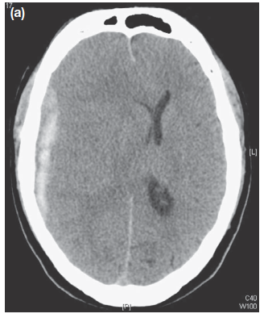
Right-sided acute subdural haematoma (hyperdense).
The substantial midline shift refects brain swelling as well as bleeding this is a high-energy injury

Slide 30
Chronic subdural haematoma
Chronic subdural haematoma is a common cause of acute neurological deterioration in older adults.
Cerebral atrophy in this age group results in stretching of the corticaldural bridging veins, which are then vulnerable to
rupture.
The resulting haematoma can expand over days or
weeks by osmosis, ultimately producing symptoms of raised ICP or focal defcit

Slide 31
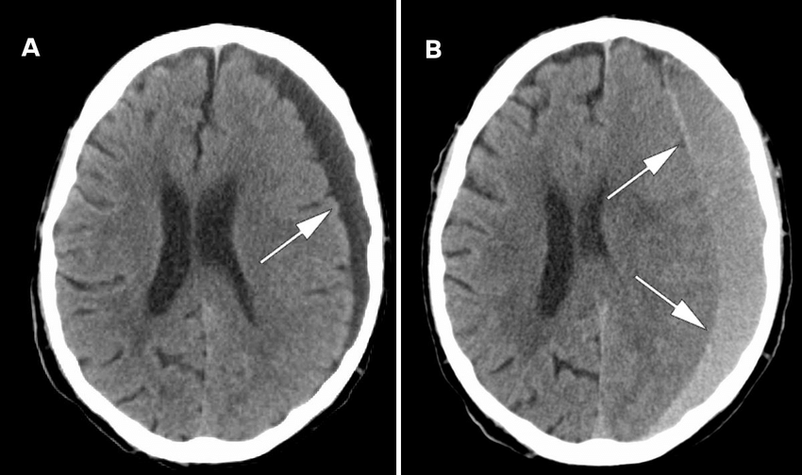
Chronic subdural haematoma

Slide 32
Chronic subdural haemorrhage
● Common in the elderly, especially those on anticoagulants
● Clinical defcits result from osmotic expansion of a degrading clot over days/weeks
● Diffuse hypodense lesion on CT
● Burr hole drainage is usually preferred

Slide 33
Concussion
, second impact syndrome and postconcussive syndrome
Concussion is defined as the alteration of consciousness as a
result of closed head injury but is generally used to describe
Concussion, second impact syndrome and postconcussive syndrome

Slide 34
Traumatic subarachnoid haemorrhage
Trauma is the commonest cause of subarachnoid haemorrhage and this is managed conservatively
Cerebral contusions
Contusions are common and are found predominantly where the brain is in contact with the irregularly ridged inside of the skull

Slide 35
Coup contre-coup
‘Coup contre-coup’ contusions refer to brain injury both at
the site of impact and distant to this, where the brain impacts
on the inside of the skull as the skull and brain accelerate and
then decelerate out of synchrony with each other

Slide 36
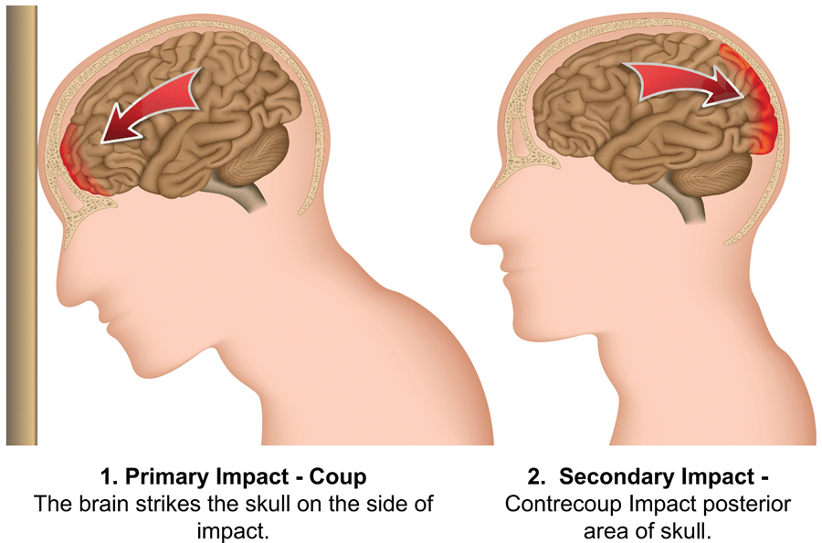

Slide 37
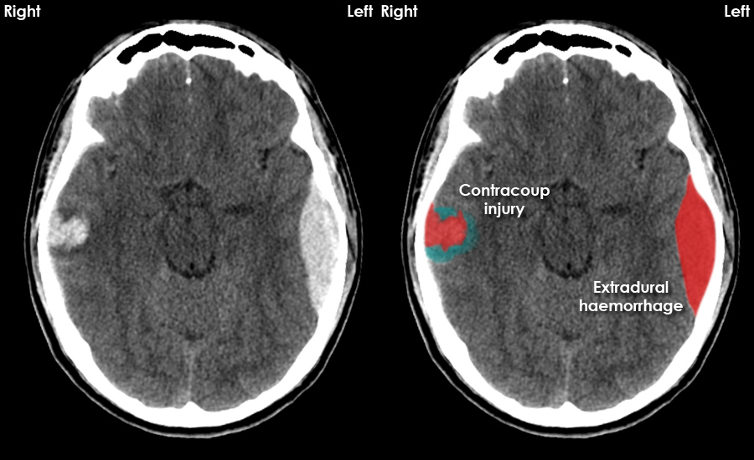
CT- Coup Contracoup Injury

Slide 38
Diffuse axonal injury
This is a form of primary brain injury seen in high-energy accidents that usually renders the patient comatose; it is associated with poor outcomes
Strictly a pathological diagnosis
Magnetic resonance imaging is more sensitive and is employed to evaluate for diffuse axonal injury in patients who fail to improve neurologically

Slide 39
Medical management of head injury
● First line ICP control involves optimising sedation, ventilation and serum sodium levels
● Paralysis and external ventricular CSF drainage are important adjuncts
● Check pituitary function, consider seizure prophylaxis, commence enteral nutrition within 72 hours

Slide 40
QUESTIONS???

Slide 41


